Slide 1
Capstone Project Agri-Tech-Farm Water Management
IIT Madras ACSE – August’21 Batch

Slide 2

IOT Capstone Micro Group - 4
Priyesh Rathore (Group Lead)
Arup Ray
Sudhakar Deekollu
Abdullah Sholapur

Slide 3
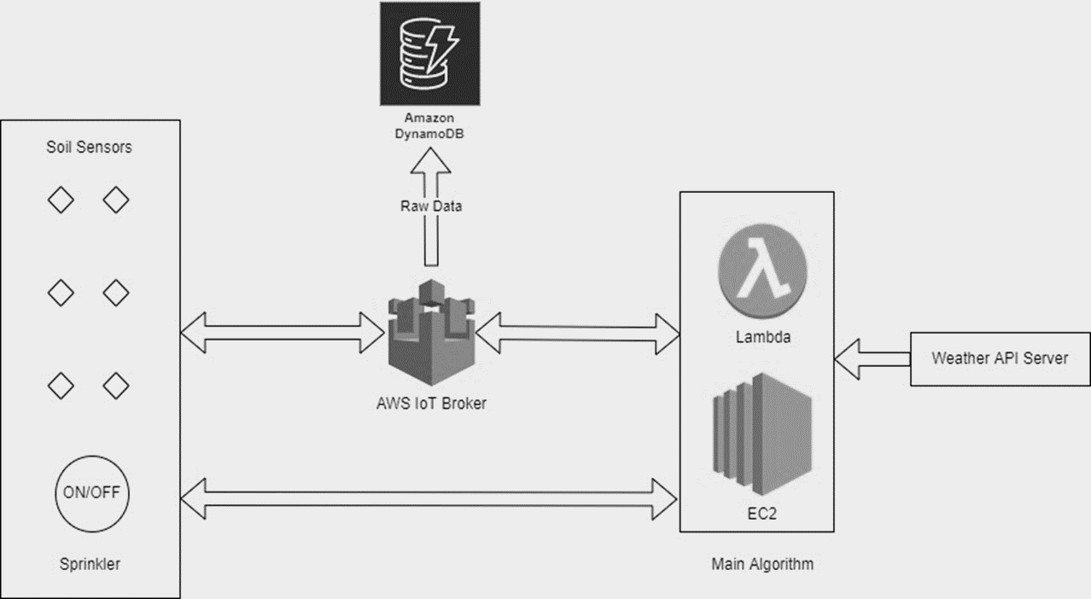
High Level Architecture

Slide 4
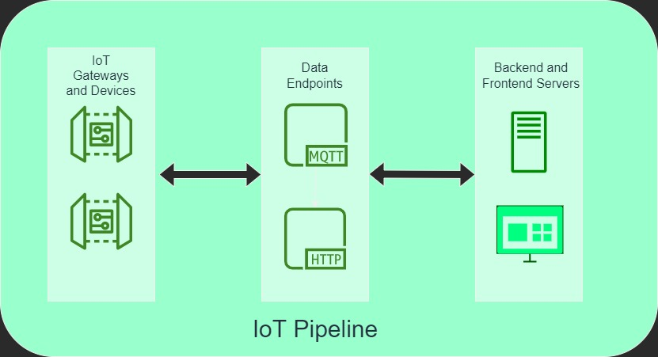

Slide 5
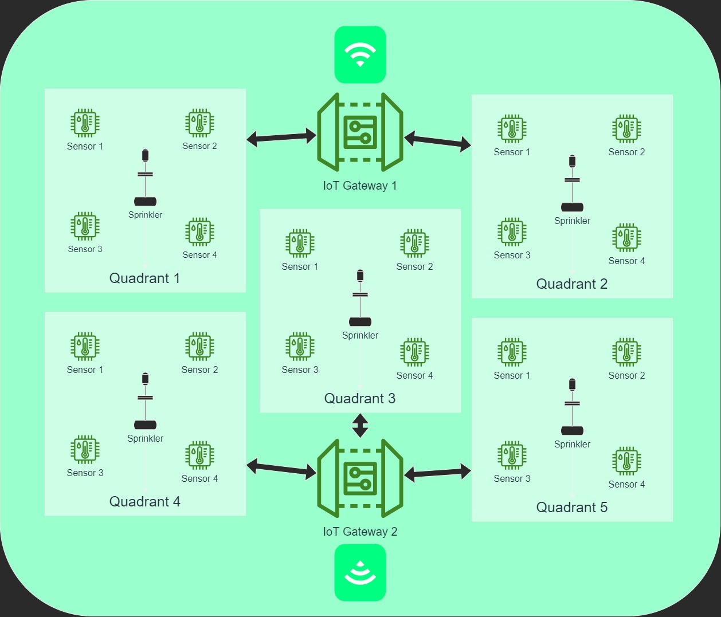
Farm divided into 5 Quadrants
Each Quadrant has 4 soil moisture sensors and one sprinkler
When at least 2 moisture sensors go below/above the threshold of pre-set values for soil moisture, sprinkler will turn ON/OFF
If it is raining in the quadrant (via openweatherAPI), sprinklers won’t turn ON.
All messaging achieved through AWS IoT Core and the decision making logic working on EC2.

Slide 6
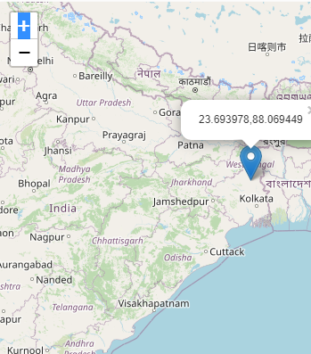
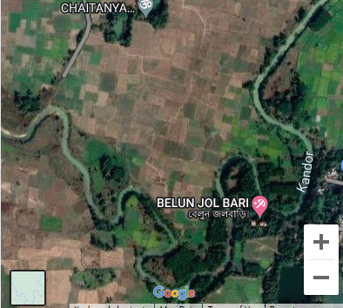
Location of Agricultural Land
Location
of Sprinklers
Sprinkler to Sprinkler Distance ~ 350 Mt
Sprinkler to Sensor Distance ~ 55 Mt

Slide 7
Latitude & Longitude of Sprinklers & Sensors

Slide 8
Major Components
Simulators:
Soil sensors and Sprinkler (actuator) simulators.
Soil sensors simulators send simulated moisture values which depend on rain, sprinkler state and quadrant temperature.
Group of 4 soil sensors and 1 sprinkler for each quadrant is registered as an IoT thing in AWS IoT Core.
Usage of OpenweatherAPI for rain and temperature parameters.
Connected to AWS IoT Core MQTT for pub/sub. Publishes soil sensors data and sprinkler telemetry periodically.
Subscribed to sprinkler topics for ON/OFF actuation.
Backend & Frontend Components:
DynamoDB for storing all the static device information (name, type, id, coordinates)
AWS IoT Core for receiving and sending MQTT data.
EC2 as main decision-making and data ingestion component.
EC2 is registered as a thing in IoT Core for Pub/Sub. Subscribes to all topics for sensor and sprinkler telemetry and publishes sprinkler ON/OFF commands to appropriate topics.
InfluxDB for application data (hosted at the EC2) as well as visualization Dashboards.
Open Weather API integrated in backend (EC2) for weather monitoring purposes.
Web GUI based device provisioning application.

Slide 9
MQTT Topic(s) Structure
TOPIC NAME | TOPIC STRUCTURE | TOPIC EXAMPLE
SOIL SENSOR TOPIC | <company name>/<quadrant>/soil_sensors | "petrichor_agritech/quadrant_1/soil_sensors“
SPRINKLER_TELEMETRY_TOPIC | <company name>/<quadrant>/sprinkler_telemetry | "petrichor_agritech/quadrant_1/sprinkler_telemetry"
SPRINKLER_COMMAND_TOPIC | <company name>/<quadrant>/sprinkler_command | "petrichor_agritech/quadrant_1/sprinkler_command"

Slide 10
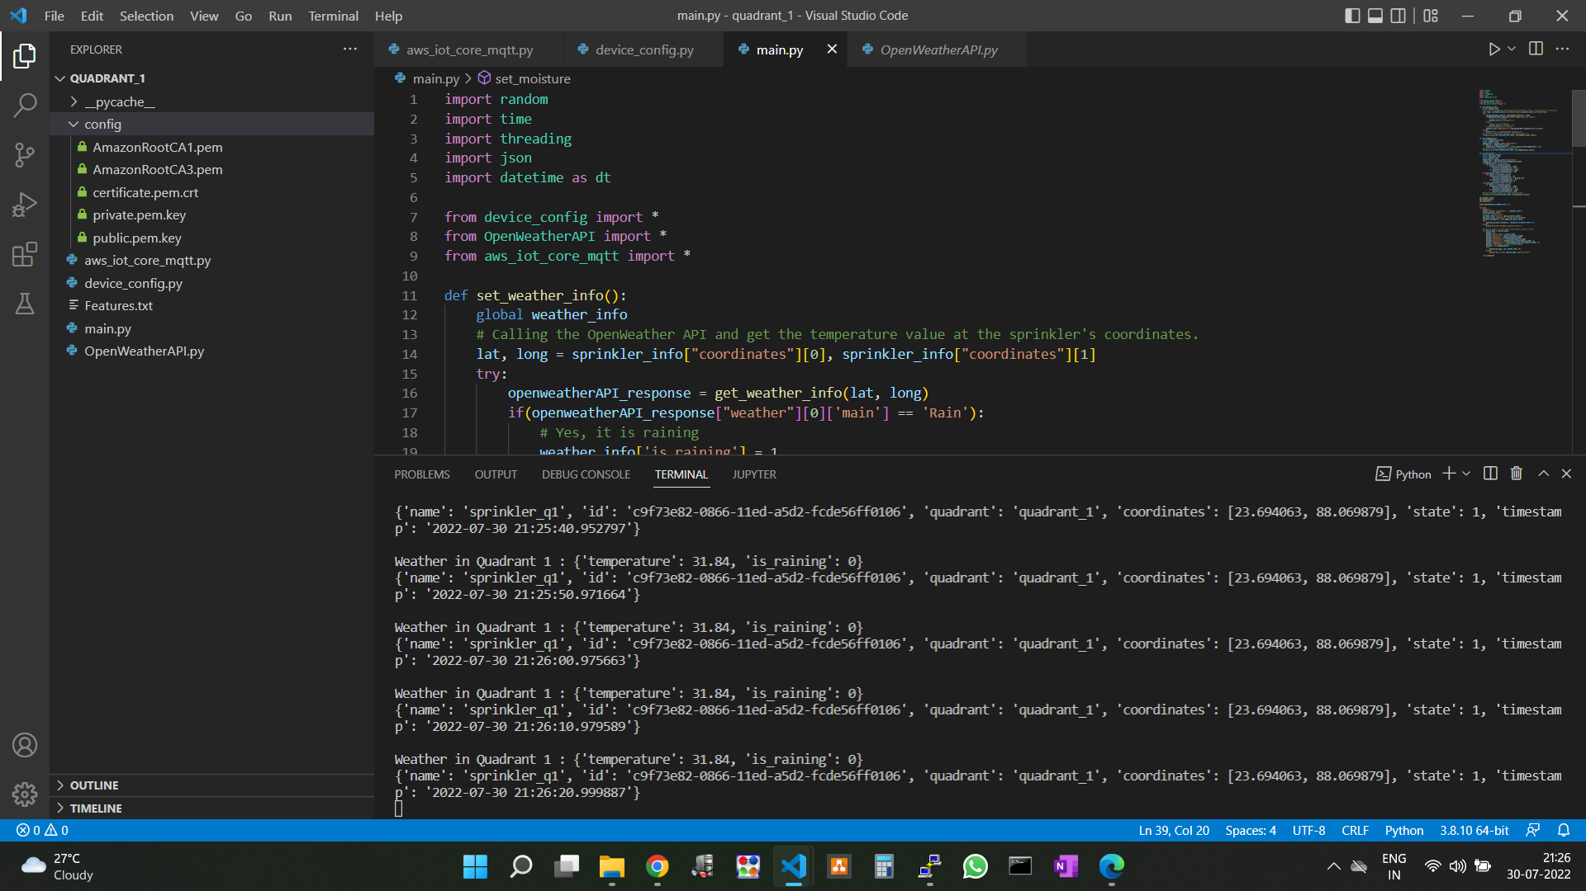
Simulator running

Slide 11
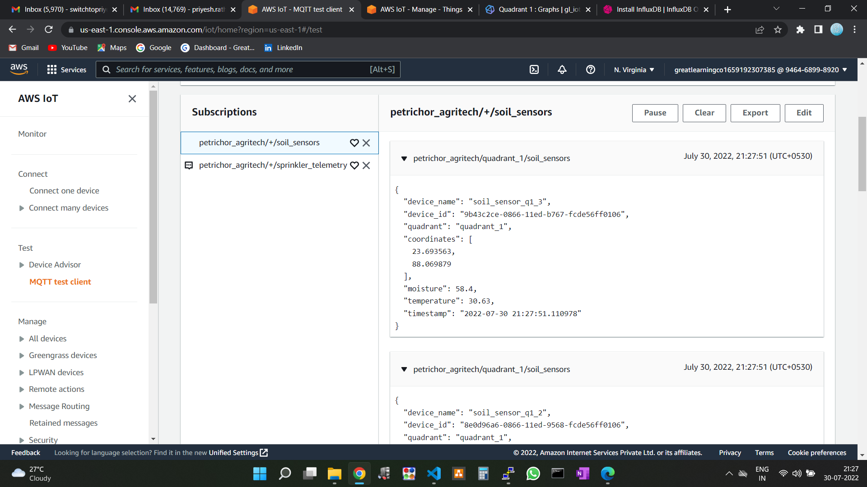
Aws iot core receiving MQTT data

Slide 12
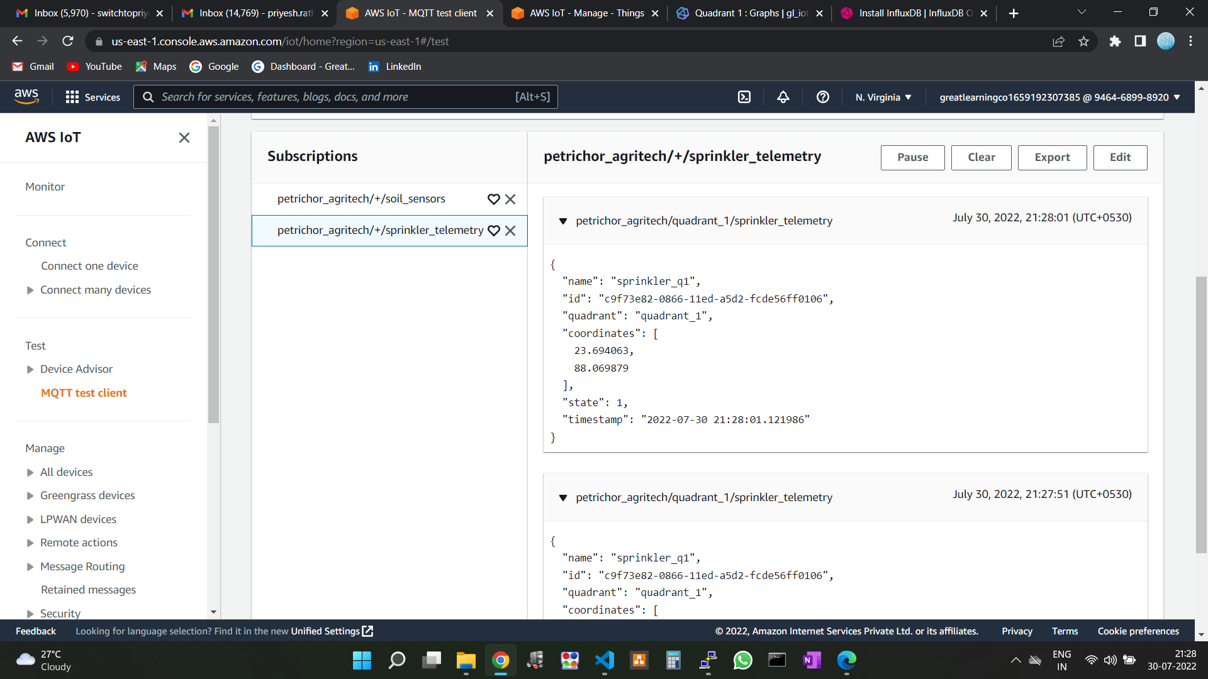
Aws iot core receiving MQTT data

Slide 13
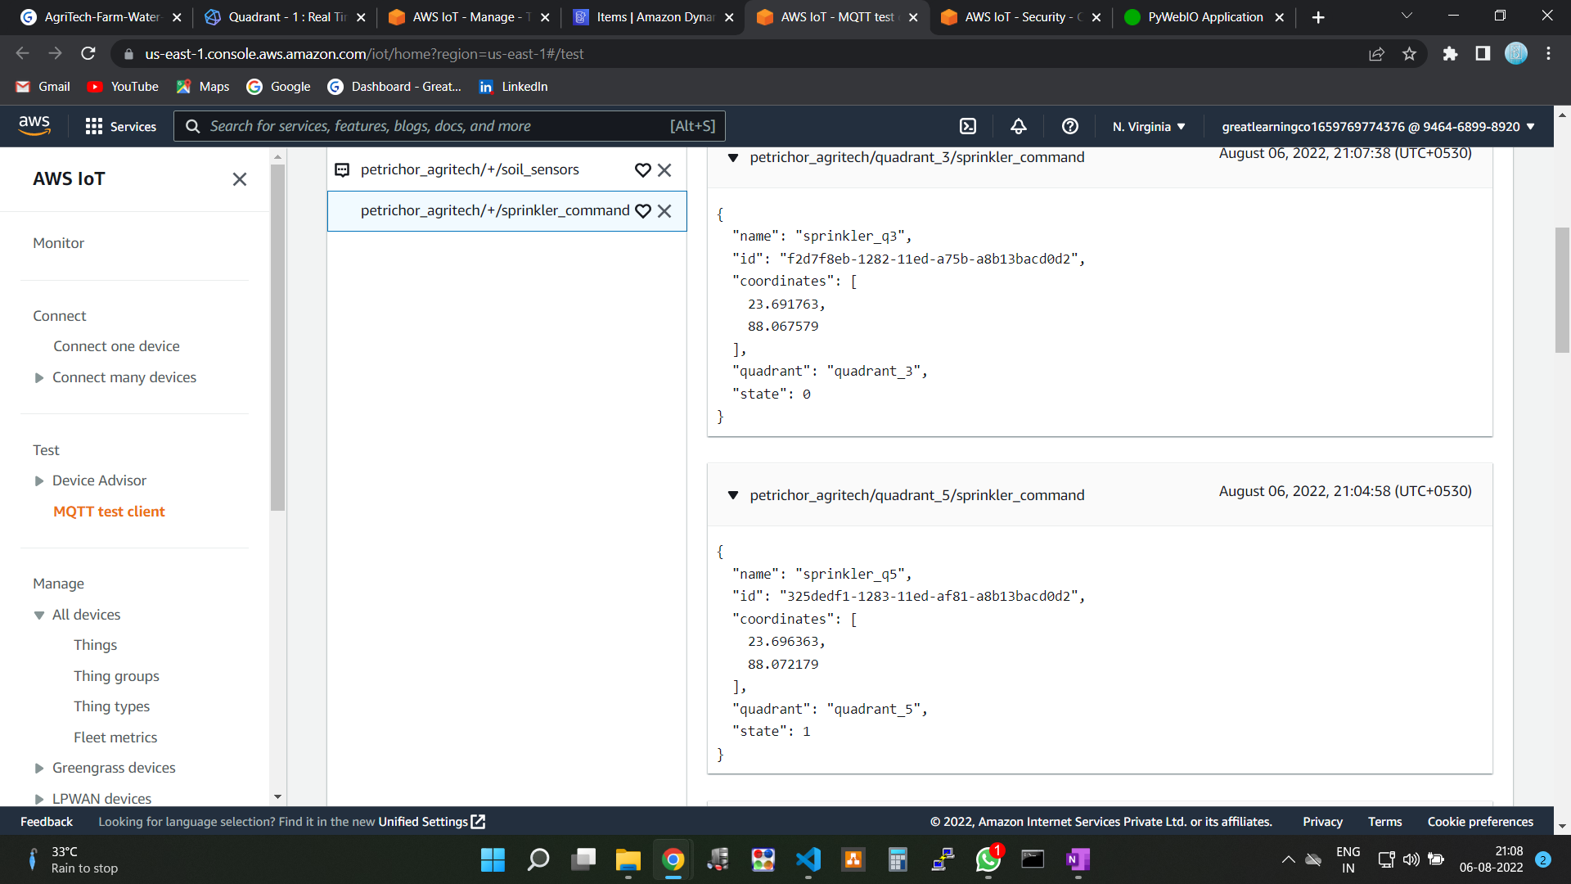
Aws iot core receiving MQTT data

Slide 14
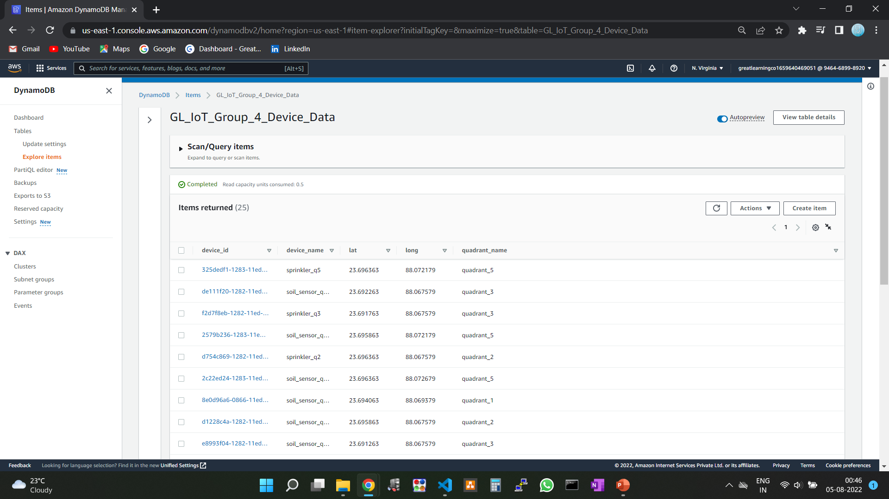
Aws Dynamodb : Static device information

Slide 15
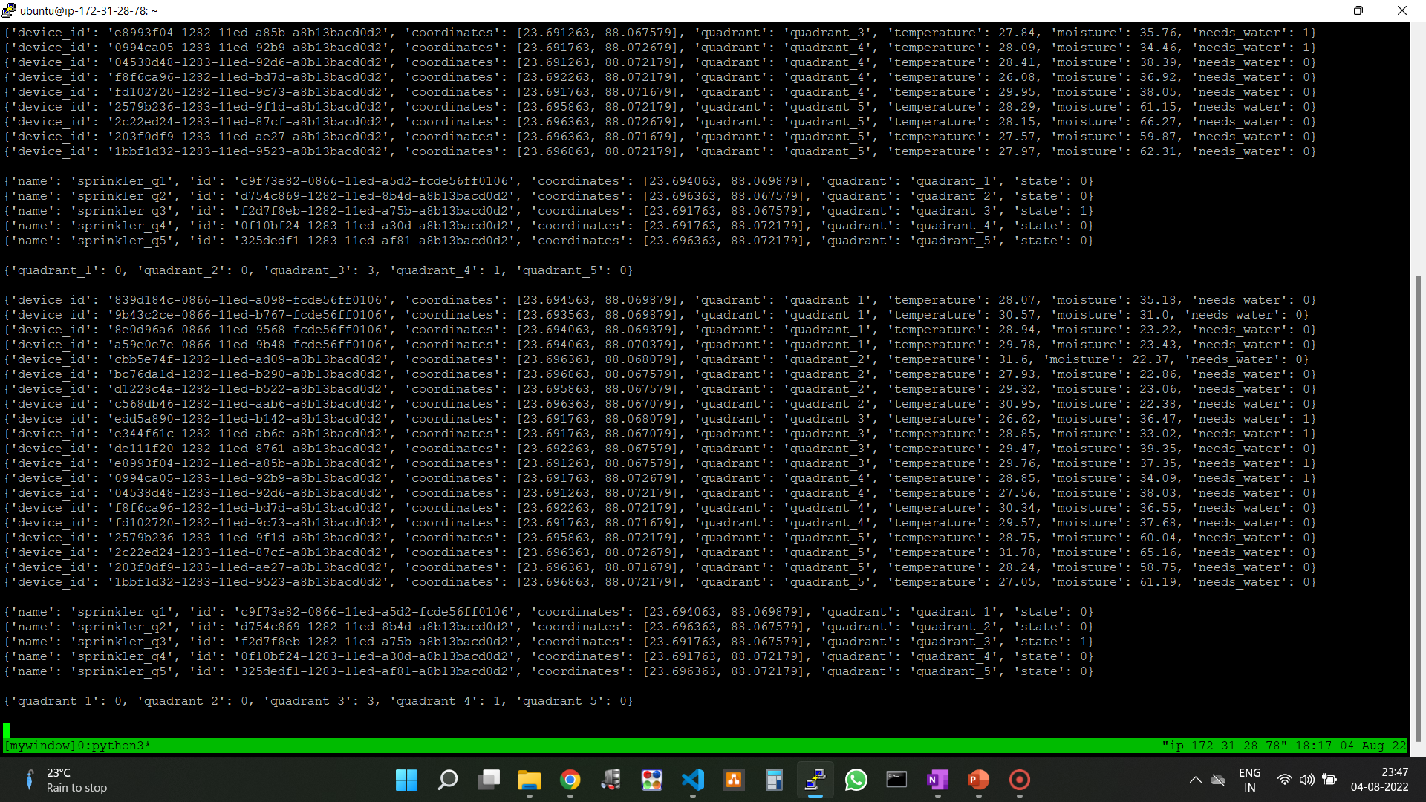
Backend (EC2) Running

Slide 16
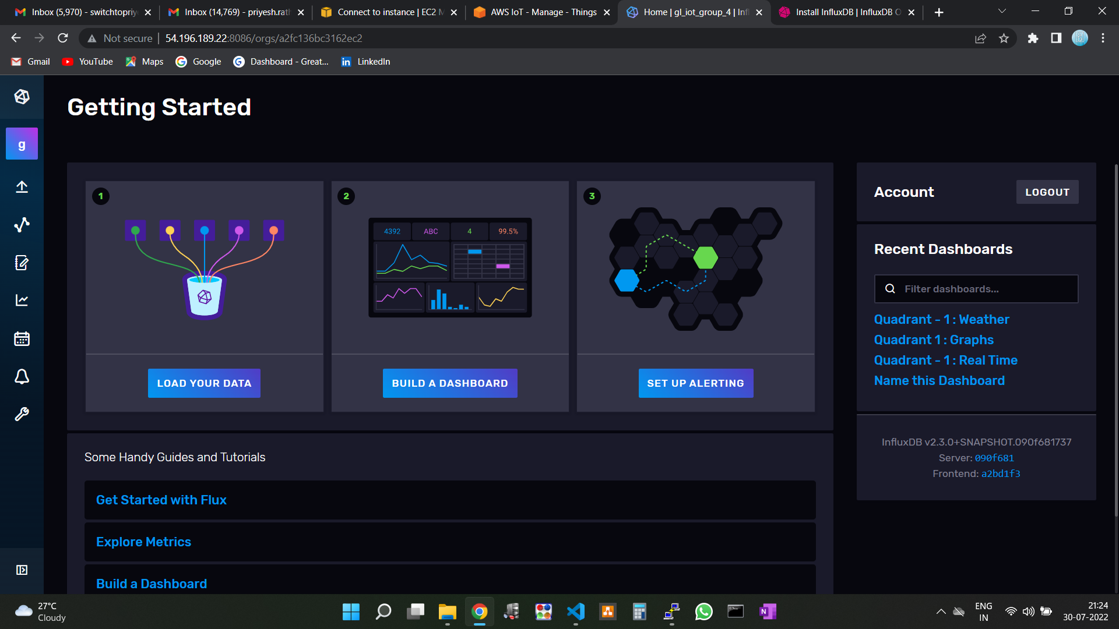
Influxdb home page

Slide 17
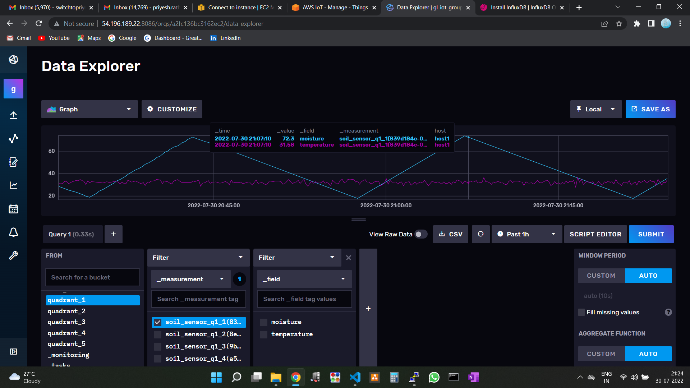
Influxdb Data explorer

Slide 18
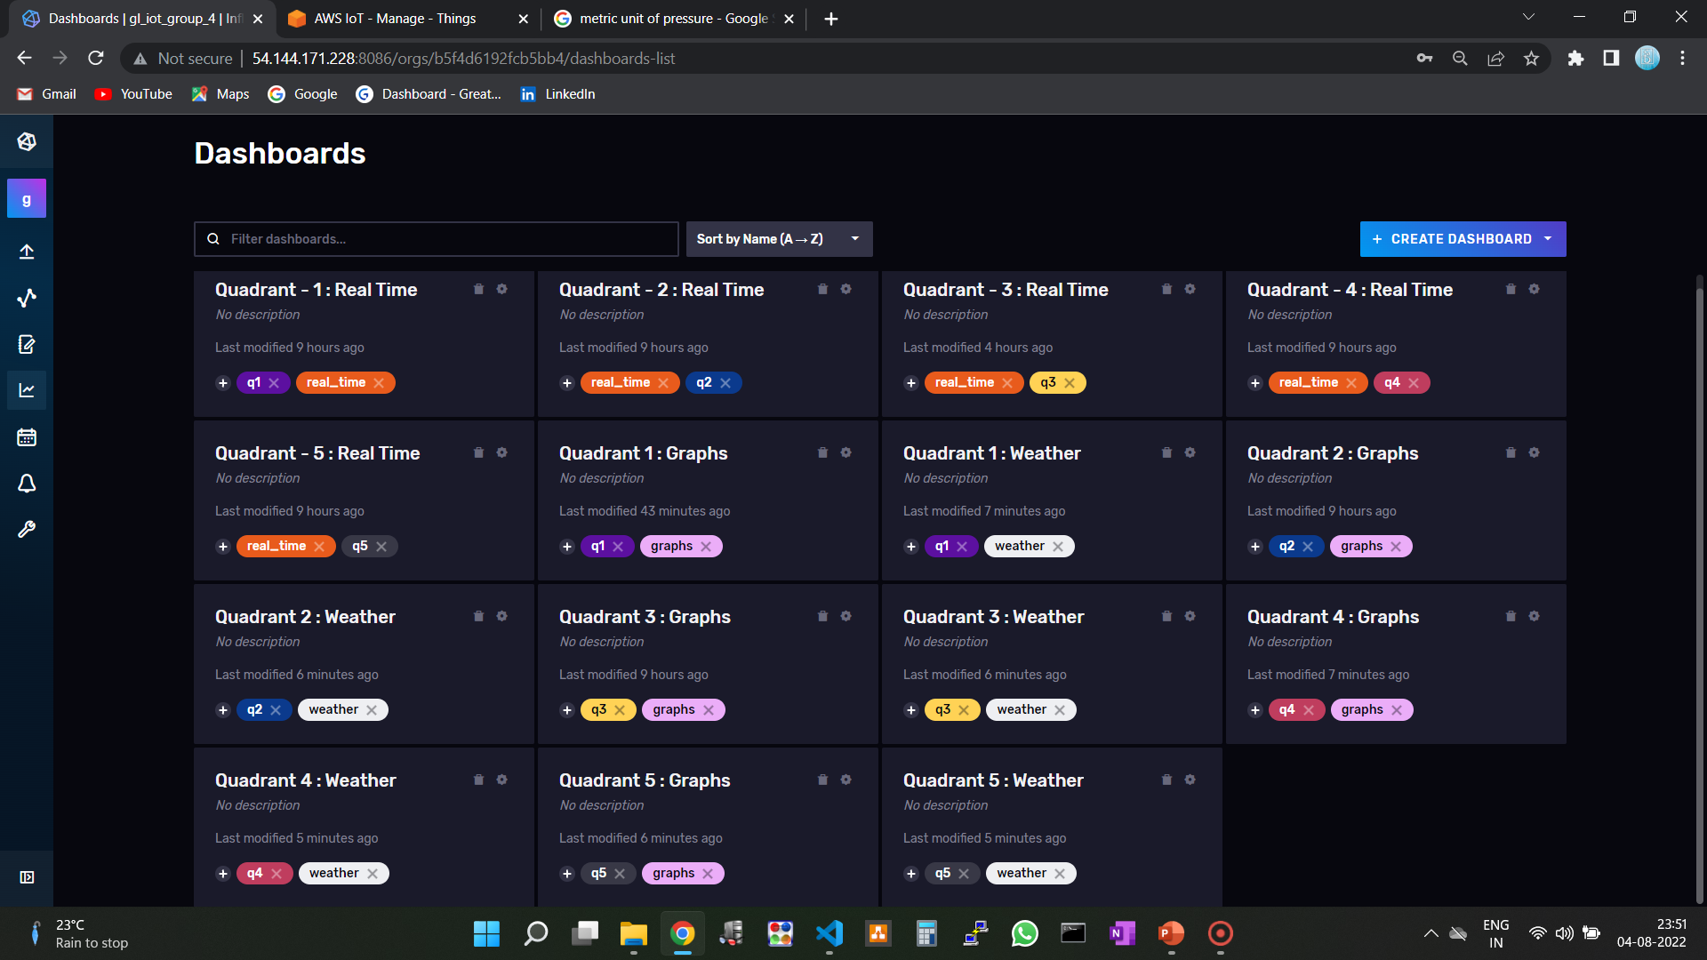
DASHBOARDS

Slide 19
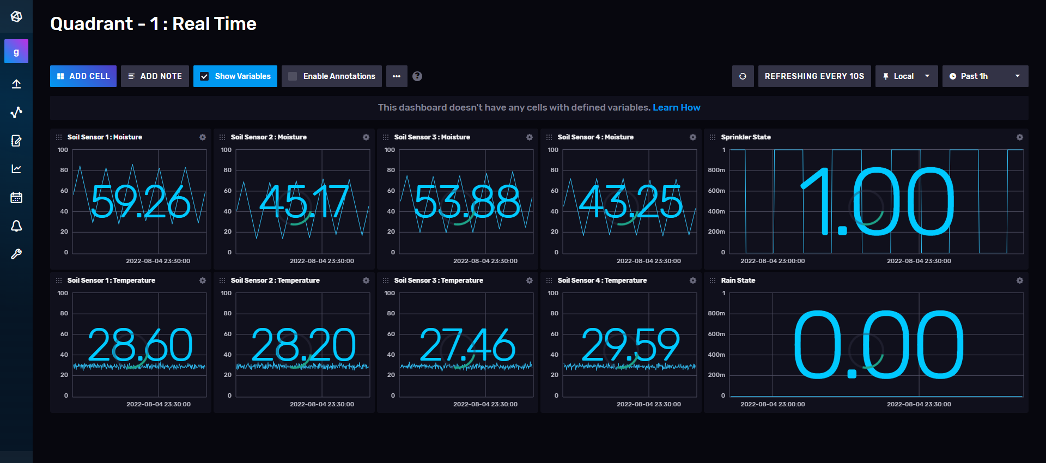
DASHBOARDS

Slide 20
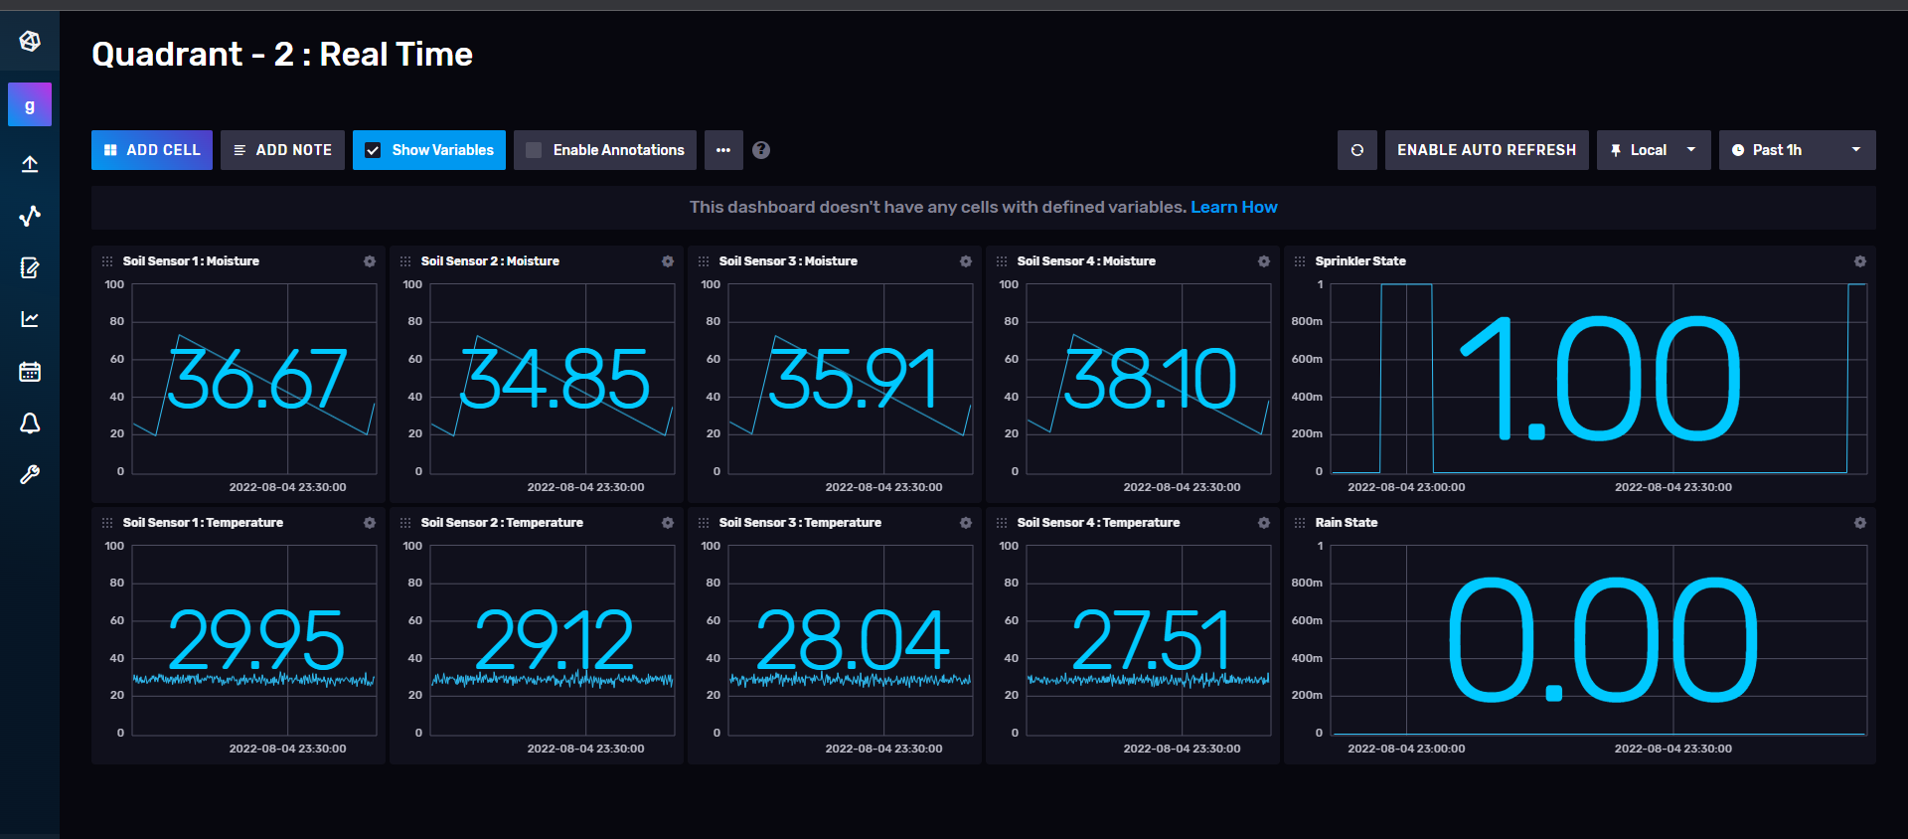
DASHBOARDS

Slide 21
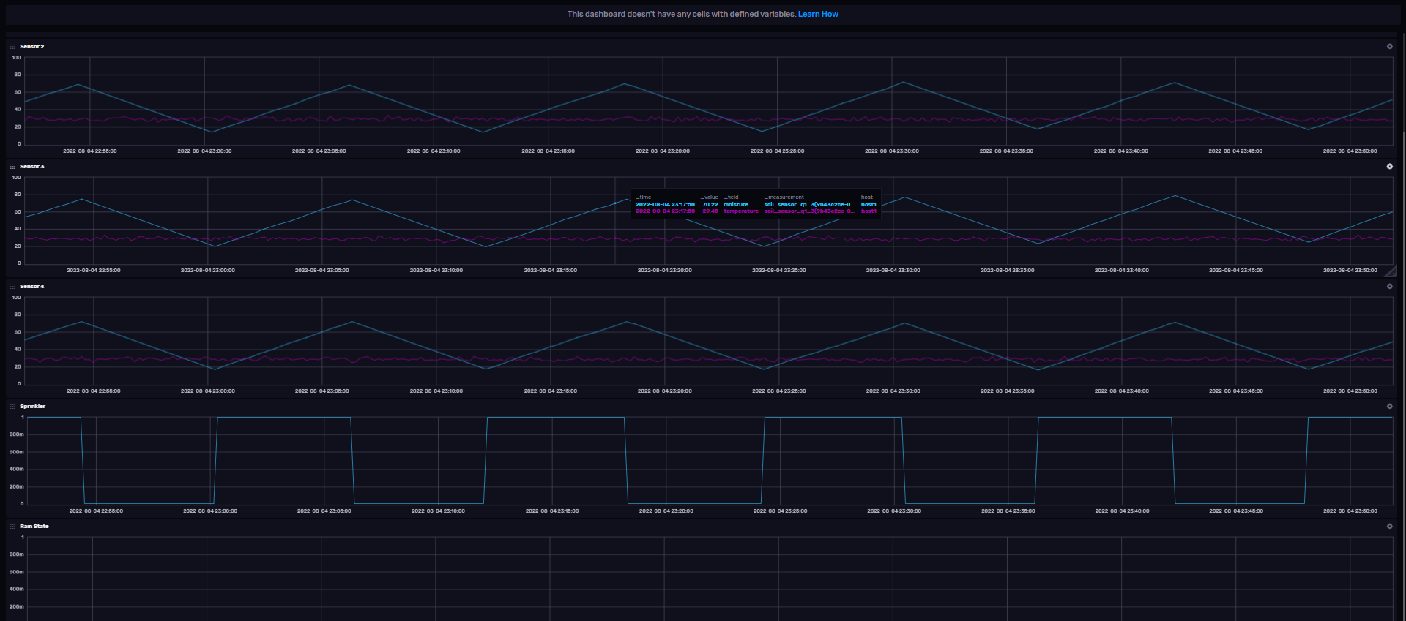
DASHBOARDS

Slide 22
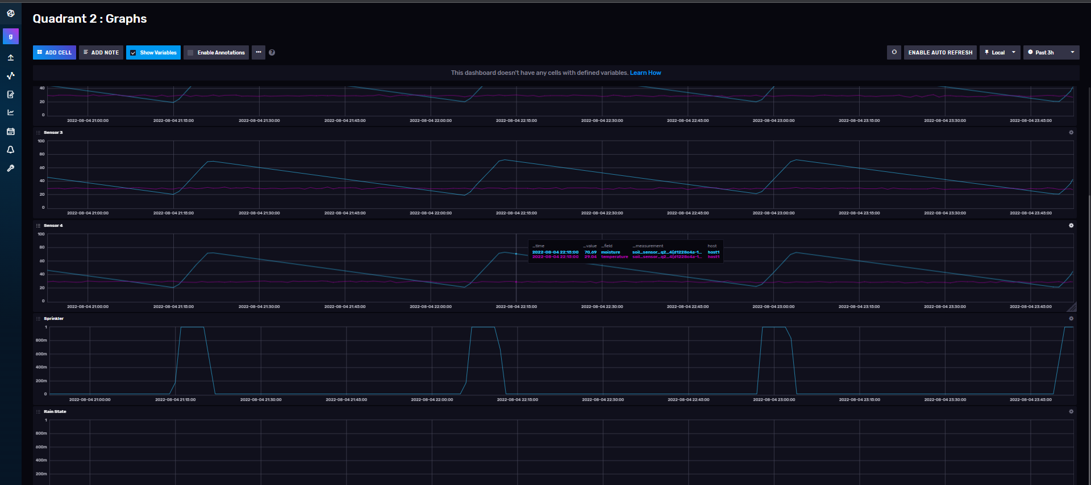
DASHBOARDS

Slide 23
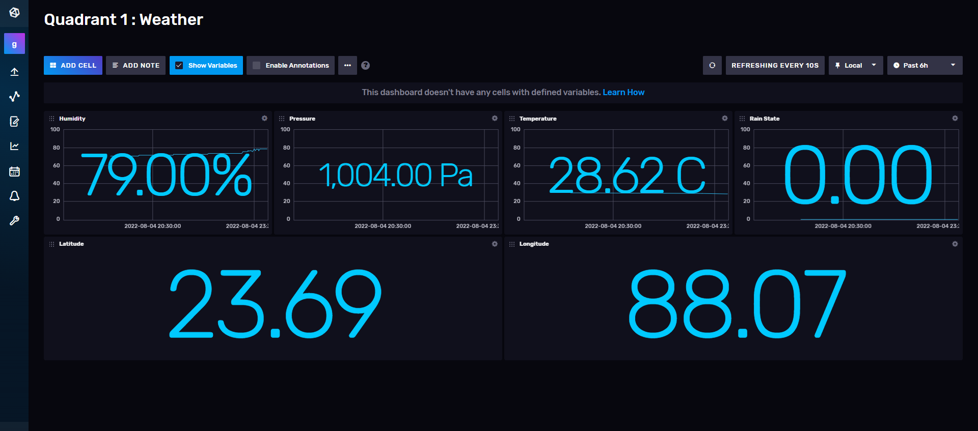
DASHBOARDS

Slide 24
Scalability
The backend application is completely dynamic i.e. it doesn’t require any hard-coding in terms of device information.
When the backend application starts running it subscribes the MQTT topics using wildcards. So even if there is data on new topics it will still receive the data.
Then as soon as it gets the device packets, it starts keeping and updating a real-time buffer for all the devices (soil sensors and sprinklers), maintaining real-time information for those devices.
If it receives a MQTT message for a device that is not present in its buffer then it adds the device to the buffer, creates appropriate measurements (storage) in the InfluxDB and according to its quadrant it will start acting on its readings.
So adding devices will be a task for the field only and the backend will automatically adjust the data ingestion and control logic as long as the MQTT topics are appropriate.
The control logic periodically iterates over each quadrant checking all the soil sensors measurements and actuates the sprinklers if needed.

Slide 25
Device Provisioning Application
This App is a web based GUI which takes parameters : Device Name, Device Type, Quadrant, Latitude, Longitude.
It then generates a uuid (Unique ID) for that device.
Then it registers it on AWS IoT Core as a thing and generates its certificates.
It saves the certificates in a folder in the same directory.
It also creates a DynamoDB entry for that created device.

Slide 26
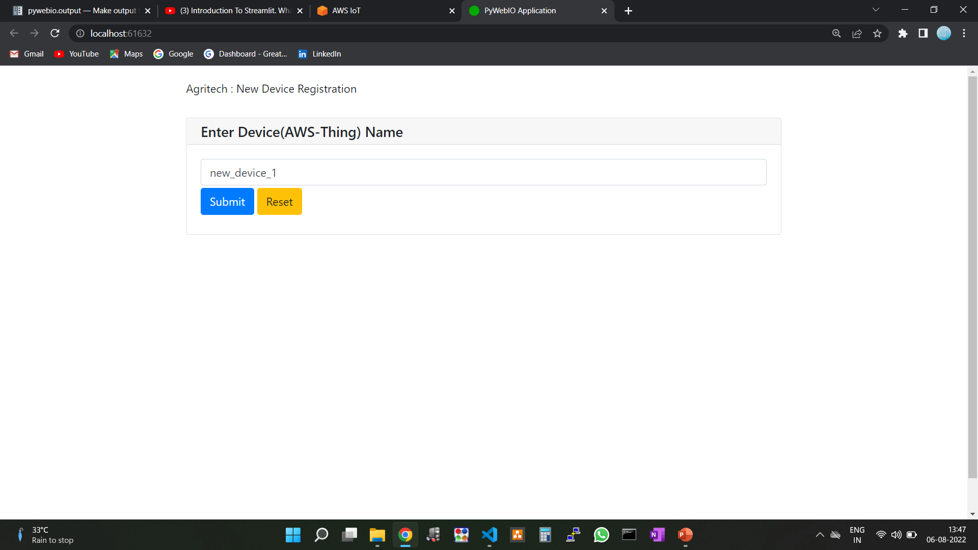
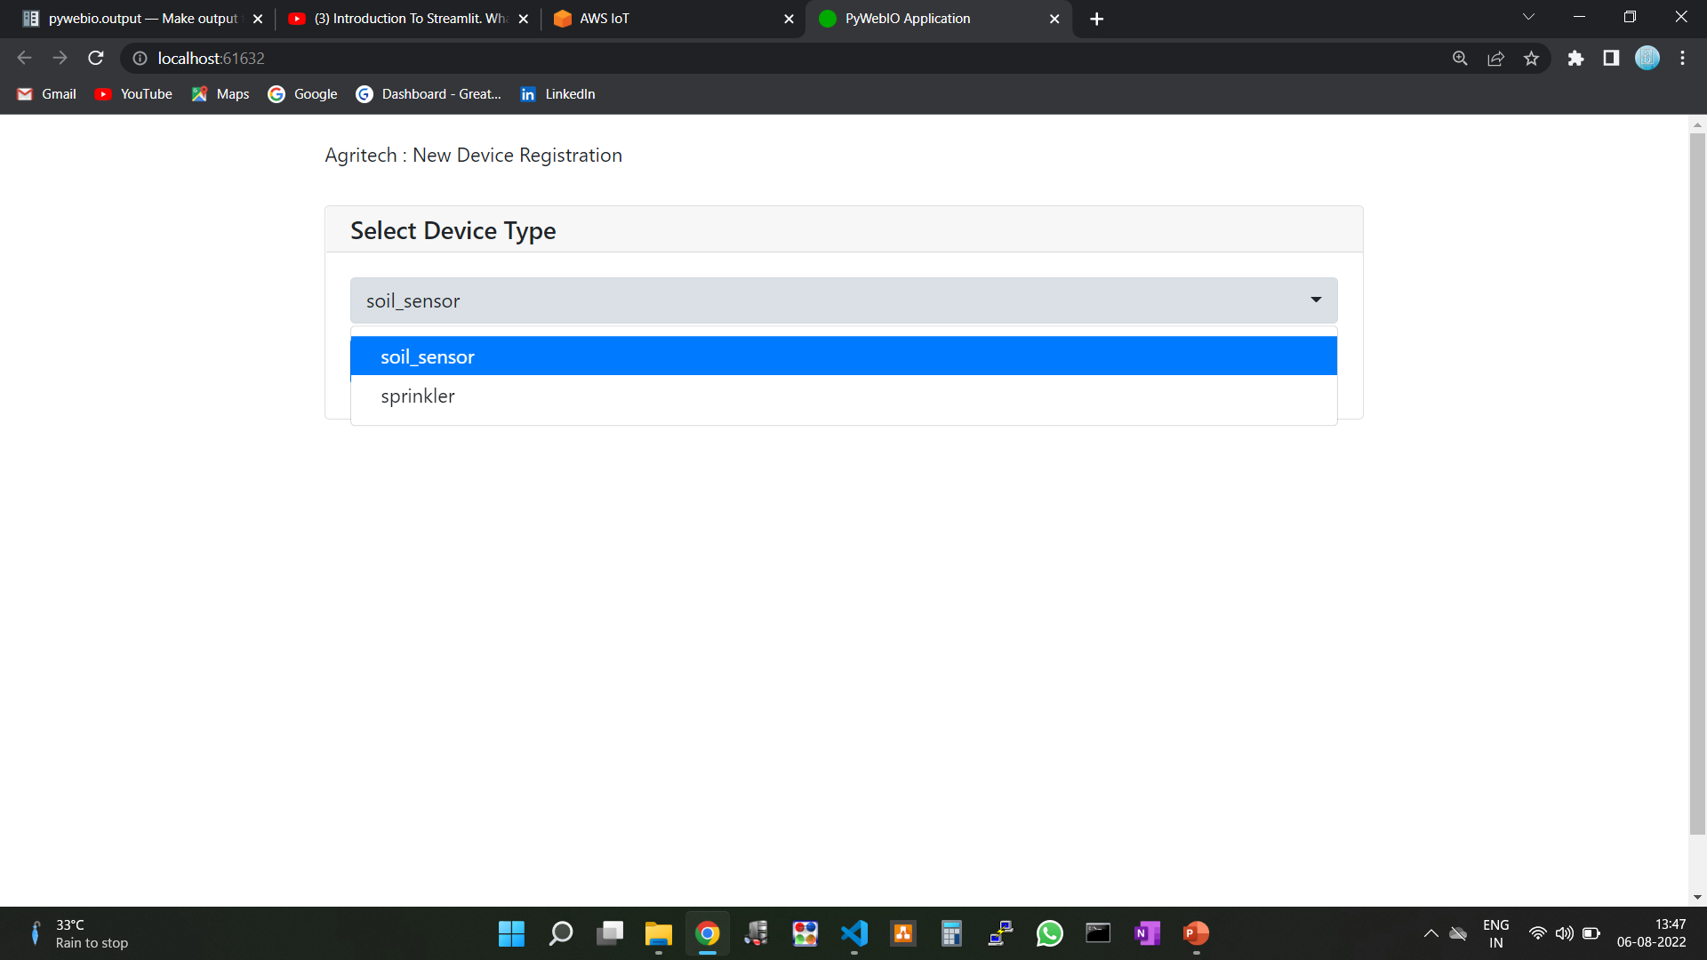
Device Provisioning Application

Slide 27
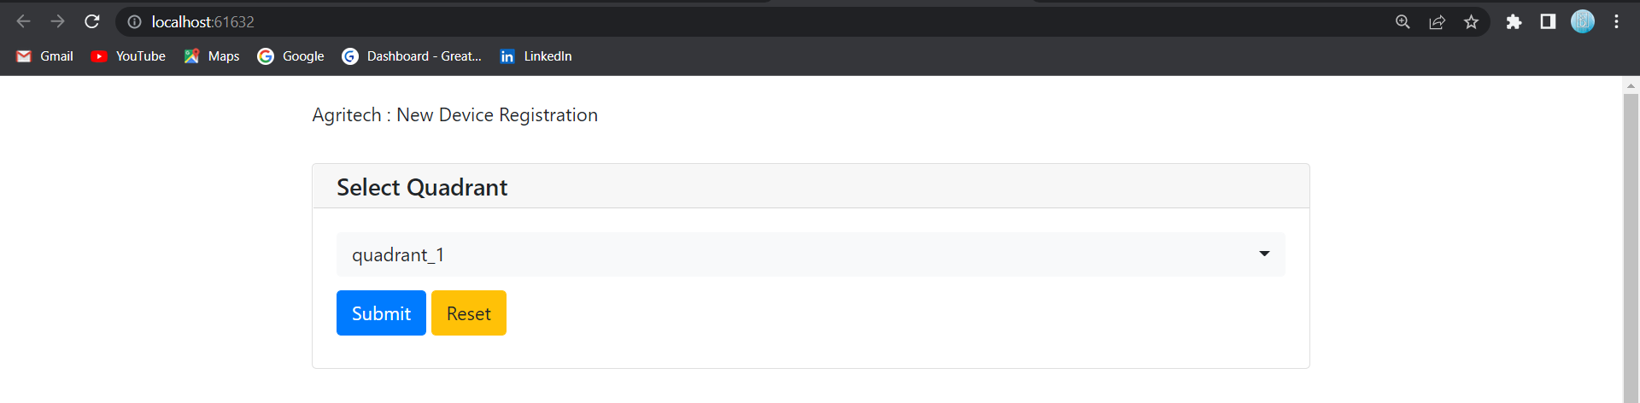
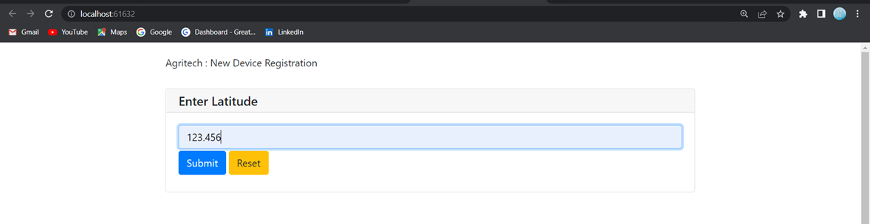
Device Provisioning Application

Slide 28
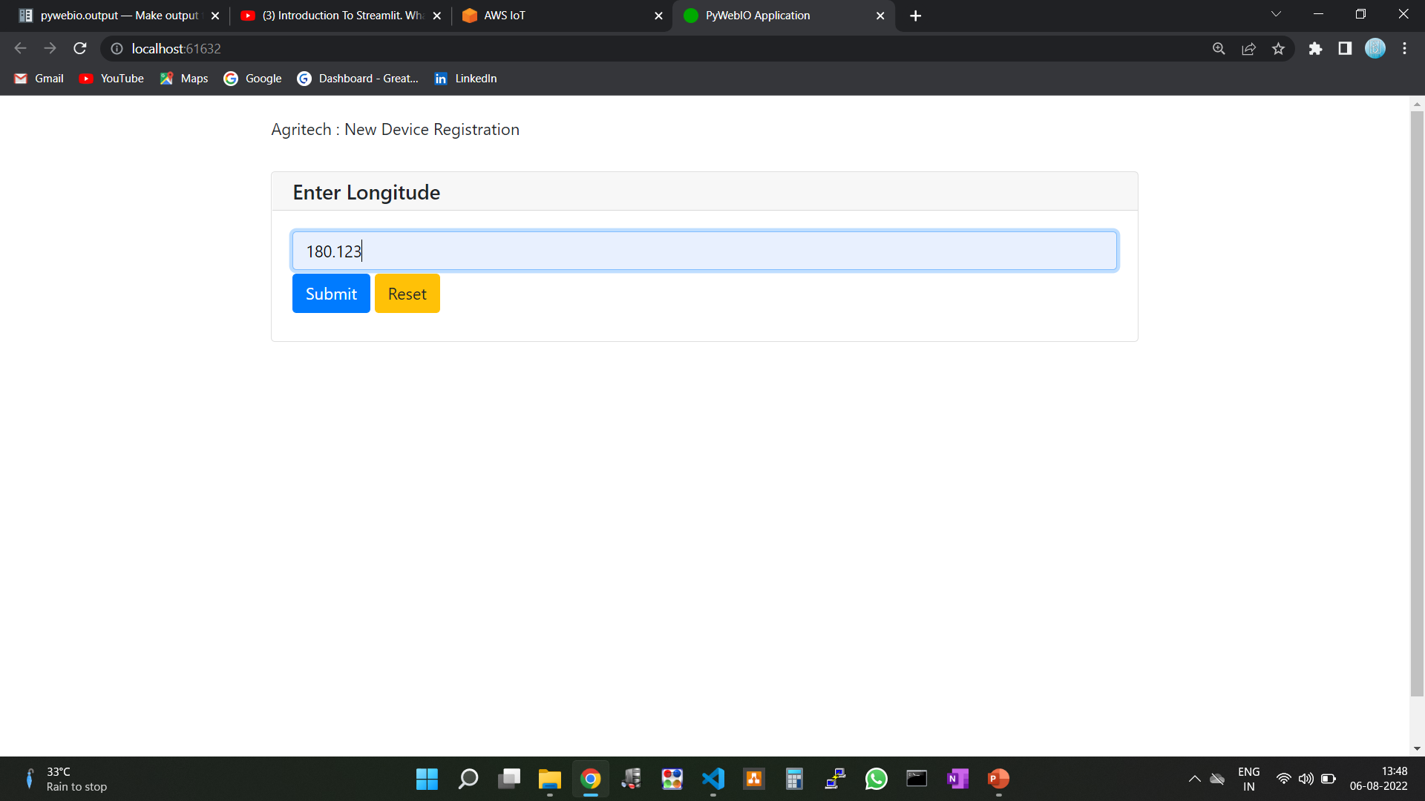
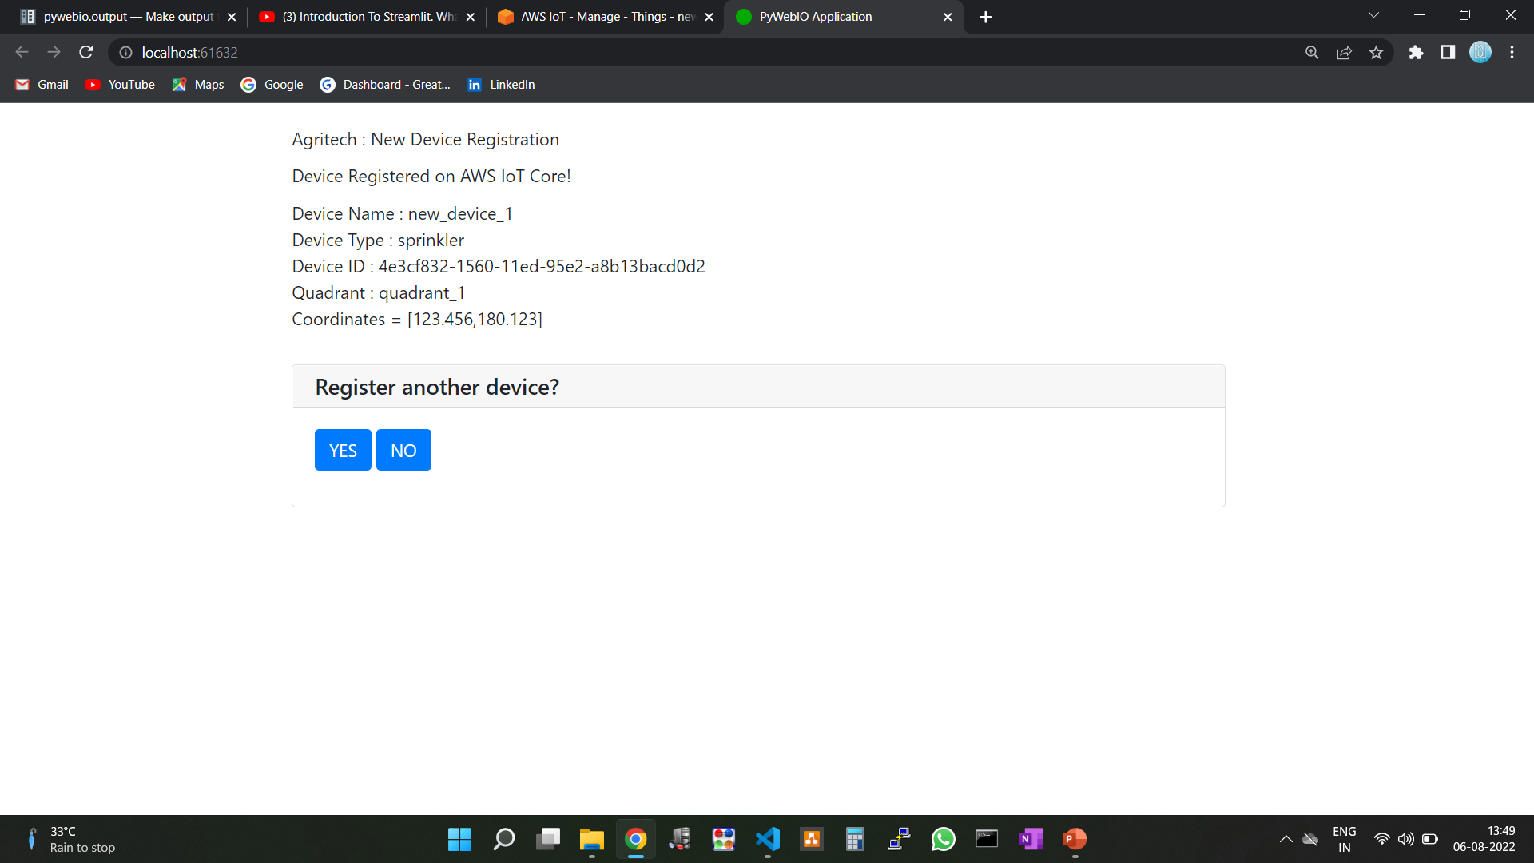
Device Provisioning Application

Slide 29
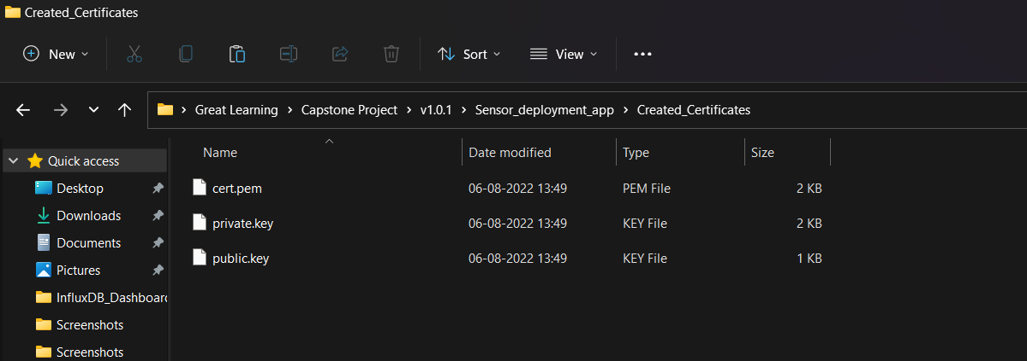
Device Provisioning Application
After this a new device is created on AWS IoT Core as a Thing with proper policy attached. Certificates are saved as shown below.
A new item is inserted into the DynamoDB table.
(See code for more details.)

Slide 30
Areas of future improvement
We are currently storing “cold” data into DynamoDB. This design can be improved because we can store it in S3 buckets which are better for cold-storage since we are using InfluxDB to store our real-time data.
Process metrics can be studied and fed as inputs to improve the software architecture which is a continuous process.

Slide 31
Thank You

